Slide 1
Big Mount Resort Price Strategy

Slide 2
Problem description
Big Mountain Resort offers spectacular views of Glacier National Park and Flathead National Forest which hosted about 350,000 people for skiing or snowboarding. Big Mountain Resort has recently installed an additional chair lift, which increases their operating costs by $1,540,000 this season. The company want to change current pricing strategy to capitalize its facilities as much as possible.
In order to find the most precise price adjusting strategy, I collected data including ticket price for resorts across United States and informational features that could be used to predict the price. The whole project including data wrangling, data exploration, pre-processing and training data and modeling.

Slide 3
Recommendation and key findings
The model suggests a ticket price $95.87 based on maketplace data. Even considering expected mean absolute error of $10.39, there is still a room for increase the ticket price.
Considering we will welcome 350,000 visitors and each visitor on average will buy 5 day tickets, the average cost increase per ticket due to installation of new chair lift is $1,540,000/350,000/5 = $0.88. Based on the expected price from my model, if we increase ticket price to $95.87, we will increase our revenue by $24,482,500. Even if we use the most conservative way of increasing price and only increase ticket price to $95.87-$10.39=$85.48, we can still increase revenue by $6,300,000.
Based on the senario modeling, I will suggest closing the shortest run, since the senario modeling results indicate closing the shortest run will not loose any support on current price. A second strategy is to increase the vertical drop by adding a run to a point 150 feet which requiring the installation of an additional chair lift. The senario modeling result shows that this strategy will support an price increase of $1.99 which corresponding to $3,474,638 more revenue.

Slide 4
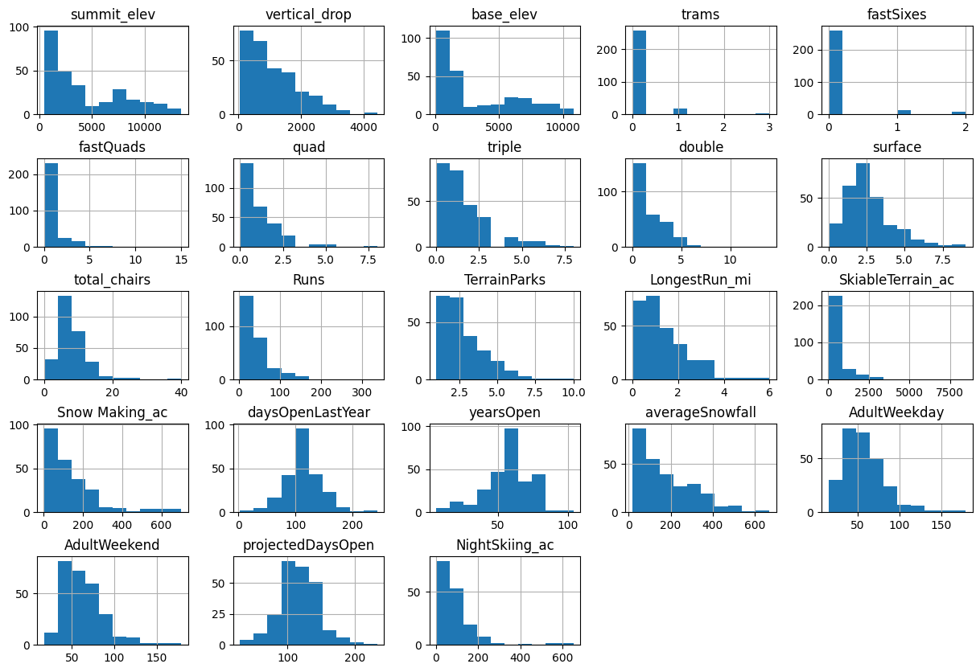
Modeling results and analysis: Data wrangling
We run standard data clean procedure. Low quality rows and columns are removed. Some data points are corrected.
AdultWeekend is selected as target feature.
Feature distribution shows reasonable quality for following modeling.

Slide 5
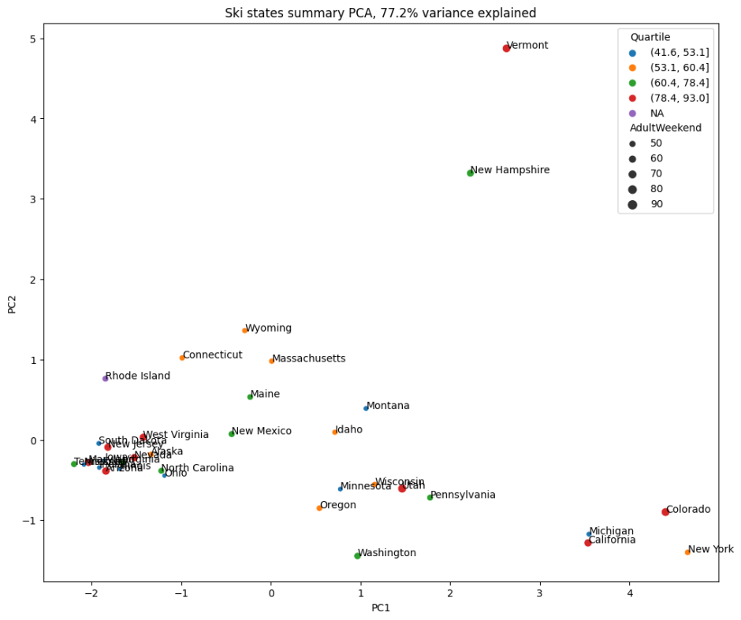
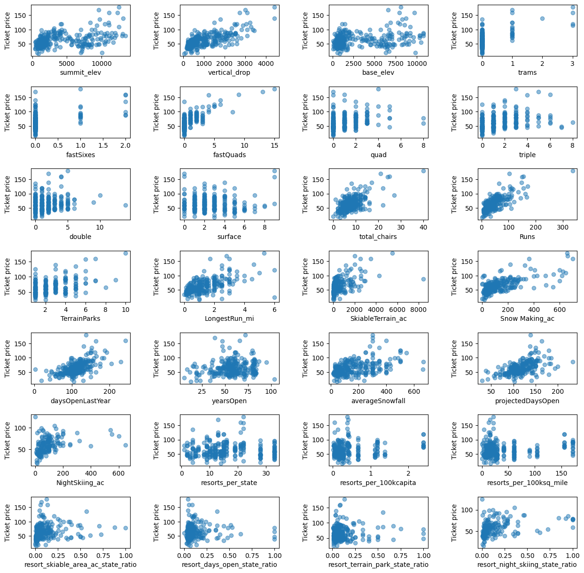
Modeling results and analysis: Data exploration
Left figure indicate the PCA plot of state resort price related features. Ticket price features are equal treated across state.
Right figure indicate the ticket price is positively correlated with vertical_drop. fastQuads, Runs and total_chairs appear quite similar and also useful.

Slide 6
Modeling results and analysis: Training
Data are split into train and test by classic ratio of 0.7 :0.3
Mean price is used as baseline performance.
Cross validation is used to handle the overfitting issue
Linear regression improve the performance of mean price mean absolute error decreasing from 19.1 to 9.42.
A second model built is Random forest model. Grid search is used to find the optimal hyperparameter.
Random forest have even better performance compared to linear regression.

Slide 7
Summary and conclusion
Based on the collected data, I successfully built random forest a model to predict the price. The model indicate that current market data support a booming up of ticket price. Other than that the model also tells several scenarios that the resort can boost their revenue by removing some run or increasing vertical drop.
For the next step, we can collect operation costs for each category and include these costs in the model. For example, if we know the cost of removing/adding a run, we can include these information to learn how its difference across resorts will contribute the ticket price.
Although Big Mountain was already fairly high on some of league charts, for example highest in Montana, I think current price still take full use of Big Mountain's facility. For all the important features we discovered that will support the ticket price. Big Mountain always rank high across resorts in the whole country, which indicate Big Mount's facility can universally satify customer's request on all the aspects. From a single aspect, Big Mount may be not the best. But considering all these price supporting features as a whole package, Big Mount's ticket price should be much higher than its current price.
We can build an app or web server to incorporate the model as backend server. We can make all the tuningable features or parameters available in the frontend. In such a case, business leaders can got the expected price from their novel combination business strategies.

